Slide 1
React

Slide 2
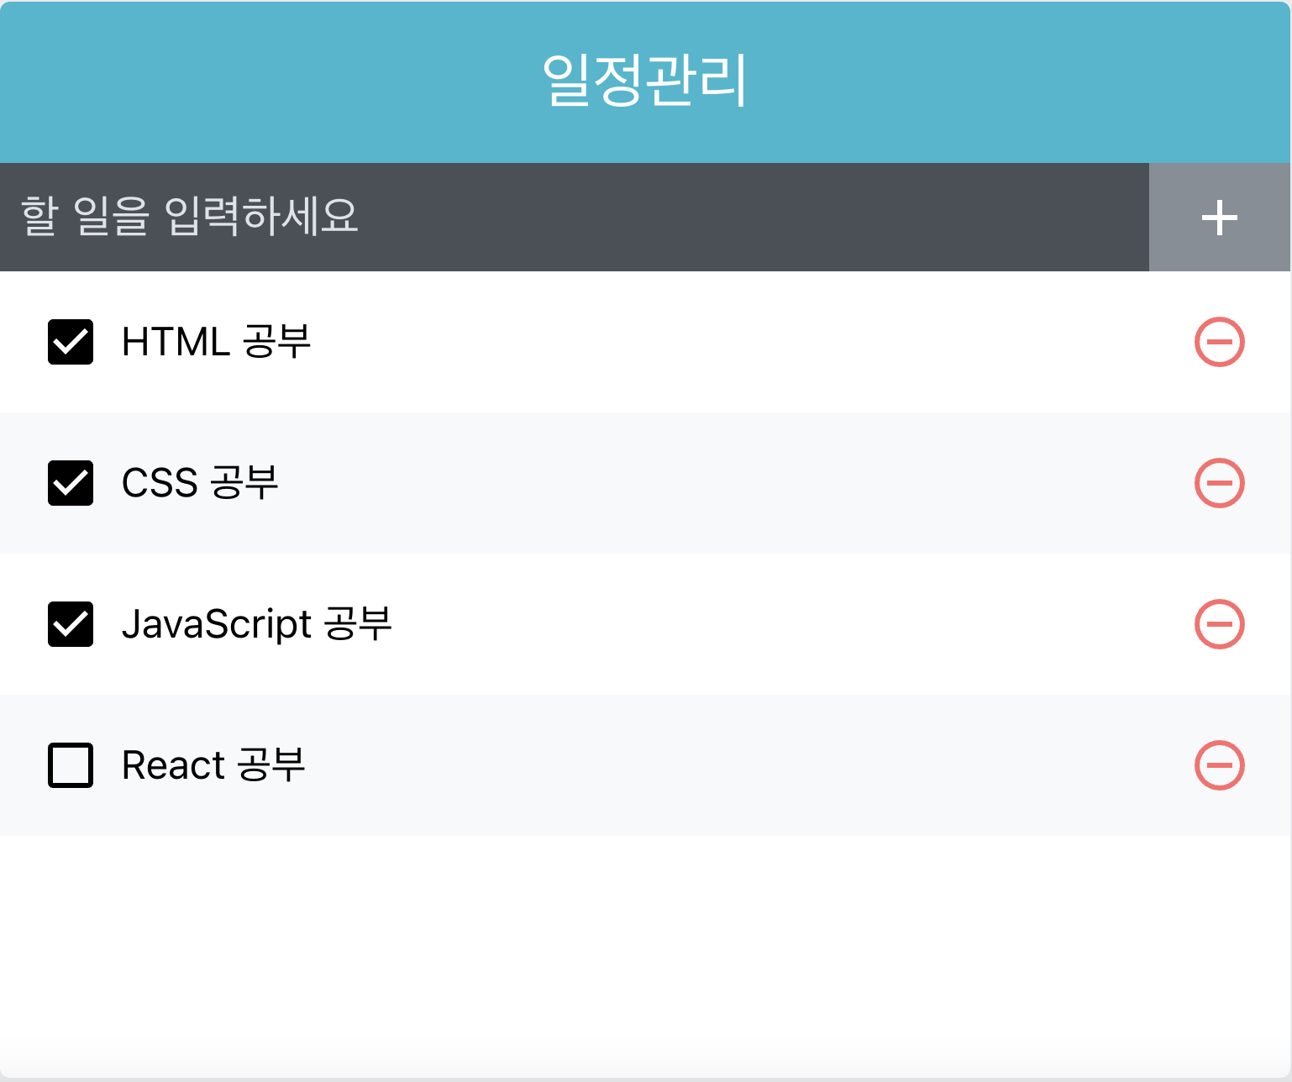

Slide 3
[
{
"id": 1,
"text": "HTML 공부",
"checked": true
},
{
"id": 2,
"text": "CSS 공부",
"checked": true
},
{
"id": 3,
"text": "JavaScript 공부",
"checked": true
},
{
"id": 4,
"text": "React 공부",
"checked": true
}
]
todos.json

Slide 4
import React, {useState, useRef, useCallback} from 'react';
import TodoTemplate from "./TodoTemplate";
import TodoInsert from "./TodoInsert";
import TodoList from "./TodoList";
import data from './todos.json';
export default function App(){
const [todos, setTodos] = useState(data);
const nextId = useRef(todos.length)

Slide 5
const handleInsert = useCallback((text) =>{
const todo = {
id:nextId.current,
text,
checked:true
}
const newTodos = todos.concat(todo);
setTodos(newTodos);
},[todos])
const handleDelete = useCallback((id) =>{
const newTodos = todos.filter(todo=>todo.id !== id);
setTodos(newTodos);
},[todos]);

Slide 6
const handleOnToggle = useCallback((id) =>{
setTodos(
todos.map(todo=>(
todo.id === id ? {...todo, checked: !todo.checked } : todo
))
);
}, [todos]);
const styles ={
marginTop: "10rem",
marginBottom: "auto",
display:"flex",
alignItems: "center",
justifyContent: "center"
}

Slide 7
return(
<div style={styles}>
<TodoTemplate>
<TodoInsert handleInsert={handleInsert}/>
<TodoList
todos={todos}
handleDelete={handleDelete}
handleOnToggle={handleOnToggle}
/>
</TodoTemplate>
</div>
)
}

Slide 8
import React from 'react';
import styled from 'styled-components';
const Template = styled.div`
width: 512px;
margin-left: auto;
margin-right: auto;
border-radius: 4px;
overflow: hidden;
`
const Title = styled.div`
background: #22b8cf;
color: white;
height: 4rem;
font-size: 1.5rem;
display: flex;
align-items: center;
justify-content: center;
`
const Content = styled.div`
background: white;
`

Slide 9
export default function TodoTemplate(props){
const {children} = props;
return(
<Template>
<Title>일정관리</Title>
<Content>{children}</Content>
</Template>
)
}

Slide 10
import React, {useCallback, useState} from 'react';
import styled from 'styled-components';
import {MdAdd} from 'react-icons/md'
const InsertForm = styled.form`
display: flex;
background: #495057;
`
const Input = styled.input`
background: none;
outline: none;
border: none;
padding: 0.5rem;
font-size: 1.125rem;
line-height: 1.5;
color: white;
&::placeholder{
color:#dee2e6;
}
flex:1;
`

Slide 11
const Button = styled.button`
background: none;
outline: none;
border: none;
background: #868e96;
color: white;
padding-left: 1rem;
padding-right: 1rem;
font-size: 1.5rem;
display: flex;
align-items: center;
cursor: pointer;
transition: 0.1s background ease-in;
&:hover{
background: #adb5bd;
}
`

Slide 12
export default function TodoInsert(props) {
const {handleInsert} = props;
const [value, setValue] = useState('');
const handleChange = useCallback((e) =>{
setValue(e.target.value);
},[])
const handleSubmit = useCallback((e) =>{
e.preventDefault();
handleInsert(value);
setValue('');
},[handleInsert, value]);

Slide 13
return (
<InsertForm onSubmit={handleSubmit}>
<Input
value={value}
onChange={handleChange}
placeholder='할 일을 입력하세요'/>
<Button type='submit'>
<MdAdd/>
</Button>
</InsertForm>
)
}

Slide 14
import React from 'react';
import TodoListItem from "./TodoListItem";
import styled from 'styled-components';
const List = styled.div`
min-height: 320px;
max-height: 513px;
overflow: auto;
`

Slide 15
export default function TodoList(props) {
const {todos, handleDelete, handleOnToggle} = props;
return(
<List>
{todos.map(todo=>(
<TodoListItem
key={todo.id}
todo={todo}
handleDelet={handleDelete}
handleOnToggle = {handleOnToggle}
/>
))
}
</List>
)
}

Slide 16
import React from 'react';
import {
MdCheckBoxOutlineBlank,
MdCheckBox,
MdRemoveCircleOutline
} from "react-icons/md";
import styled from 'styled-components';
import cn from 'classnames'
const ListItem = styled.div`
padding: 1rem;
display: flex;
align-items: center;
&:nth-child(even){
background: #f8f9fa;
}
`

Slide 17
const Checkbox = styled.div`
cursor: pointer;
flex:1;
display:flex;
align-items: center;
svg{
font-size: 1.5rem;
}
`
const Todos = styled.div`
margin-left: 0.5rem;
flex:1;
`

Slide 18
const Delete = styled.div`
display: flex;
align-items: center;
font-size: 1.5rem;
color: #ff6b6b;
cursor: pointer;
&:hover{
color:#ff8787;
};
&+&{
border-top: 1px solid #dee2e6;
}
`

Slide 19
export default function TodoListItem(props) {
const {todo, handleDelete, handleOnToggle} = props
const {id, text, checked} = todo;
return(
<div>
<div onClick={()=>handleOnToggle(id)}>
{checked ? <MdCheckBox/>:<MdCheckBoxOutlineBlank/>}
<Todos>
{text}
</Todos>
</div>
<div onClick={()=>handleDelete(id)}>
<MdRemoveCircleOutline/>
</div>
</div>
)
}

Slide 20
Todos Redux(useSelector, useDispatch)

Slide 21
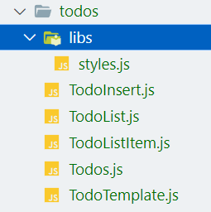
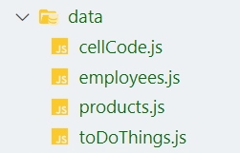
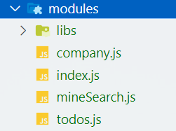
모듈 구성

Slide 22
styles.js
import styled from "styled-components";
export const InsertForm = styled.form`
display: flex;
background: #495057;
`
export const Input = styled.input`
background: none;
outline: none;
border: none;
padding: 0.5rem;
font-size: 1.125rem;
line-height: 1.5;
color: white;
&::placeholder{
color:#dee2e6;
}
flex:1;
`

Slide 23
styles.js
export const Button = styled.button`
background: none;
outline: none;
border: none;
background: #868e96;
color: white;
padding-left: 1rem;
padding-right: 1rem;
font-size: 1.5rem;
display: flex;
align-items: center;
cursor: pointer;
transition: 0.1s background ease-in;
&:hover{
background: #adb5bd;
}
`

Slide 24
styles.js
export const List = styled.div`
min-height: 320px;
max-height: 513px;
overflow: auto;
`
export const ListItem = styled.div`
padding: 1rem;
display: flex;
align-items: center;
&:nth-child(even){
background: #f8f9fa;
}
`
export const Checkbox = styled.div`
cursor: pointer;
flex:1;
display:flex;
align-items: center;
svg{
font-size: 1.5rem;
}
`

Slide 25
styles.js
export const Todos = styled.div`
margin-left: 0.5rem;
flex:1;
`
export const Delete = styled.div`
display: flex;
align-items: center;
font-size: 1.5rem;
color: #ff6b6b;
cursor: pointer;
&:hover{
color:#ff8787;
};
&+&{
border-top: 1px solid #dee2e6;
}
`

Slide 26
styles.js
export const styles ={
marginTop: "10rem",
marginBottom: "auto",
display:"flex",
alignItems: "center",
justifyContent: "center"
}
export const Template = styled.div`
width: 512px;
margin-left: auto;
margin-right: auto;
border-radius: 4px;
overflow: hidden;
`

Slide 27
styles.js
export const Title = styled.div`
background: #22b8cf;
color: white;
height: 4rem;
font-size: 1.5rem;
display: flex;
align-items: center;
justify-content: center;
`
export const Content = styled.div`
background: white;
`

Slide 28
todos.js
import {toDoThings} from "../data/toDoThings";
const ADDTODO = "todos/ADDTODO"
const CHECK = "todos/CHECK"
const REMOVE = "todos/DELETE"
export const addTodo = (toDoThing) => ({type:ADDTODO, toDoThing })
export const check = (id) => ({type:CHECK, id })
export const remove = (id) => ({type:REMOVE, id })
const initialState = {
toDoThings
};

Slide 29
todos.js
export const todos =(state=initialState, actions)=>{
switch (actions.type) {
case ADDTODO:
const tmpList = [...state.toDoThings,
{
id: state.toDoThings.length + 1,
text: actions.toDoThing,
checked: false
}
]
return {
toDoThings: tmpList
}

Slide 30
todos.js
case CHECK:
const cTmpList = state.toDoThings.map(toDoThing=>(
toDoThing.id === actions.id ?
{...toDoThing, checked: !toDoThing.checked } : toDoThing
))
return {
toDoThings: cTmpList
}
case REMOVE:
const rTmpList = state.toDoThings.filter(toDoThing=>
toDoThing.id !== actions.id);
return {
toDoThings: rTmpList
}
default:
return state;
}
}

Slide 31
Todos.js
import TodoTemplate from "./TodoTemplate";
import TodoInsert from "./TodoInsert";
import TodoList from "./TodoList";
import {styles} from "./libs/styles"
export default function Todos(){
return(
<div style={styles}>
<TodoTemplate>
<TodoInsert/>
<TodoList/>
</TodoTemplate>
</div>
)
}

Slide 32
TodoTemplate.js
import React from 'react';
import {Template, Title, Content} from "./libs/styles";
export default function TodoTemplate(props){
const {children} = props;
return(
<Template>
<Title>일정관리</Title>
<Content>{children}</Content>
</Template>
)
}

Slide 33
TodoInsert.js
import React, {useCallback, useState} from 'react';
import {MdAdd} from 'react-icons/md'
import {addTodo} from "../../modules/todos";
import {useDispatch} from "react-redux";
import {InsertForm, Input, Button} from "./libs/styles";
export default function TodoInsert() {
const [value, setValue] = useState('');
const dispatch = useDispatch()

Slide 34
TodoInsert.js
const handleChange = useCallback((e) =>{
setValue(e.target.value);
},[value])
const handleSubmit = useCallback((e) =>{
e.preventDefault();
dispatch(addTodo(value));
setValue('');
},[value]);
return (
<InsertForm onSubmit={handleSubmit}>
<Input
value={value}
onChange={handleChange}
placeholder='할 일을 입력하세요'/>
<Button type='submit'>
<MdAdd/>
</Button>
</InsertForm>
)
}

Slide 35
TodoList.js
import React from 'react';
import TodoListItem from "./TodoListItem";
import {useSelector} from "react-redux";
import {List} from './libs/styles'
export default function TodoList(props) {
const todos = useSelector(({todos})=>todos.toDoThings)
return(
<List>
{todos.map(todo=>(
<TodoListItem
key={todo.id}
todo={todo}
/>
))
}
</List>
)
}

Slide 36
TodoListItem.js
import React from 'react';
import {
MdCheckBoxOutlineBlank,
MdCheckBox,
MdRemoveCircleOutline
} from "react-icons/md";
import {remove, check} from "../../modules/todos";
import {useDispatch} from "react-redux";
import {ListItem, Checkbox, Todos, Delete} from './libs/styles'

Slide 37
TodoListItem.js
export default function TodoListItem(props) {
const dispatch = useDispatch()
const {todo} = props
const {id, text, checked} = todo;
return(
<ListItem>
<Checkbox onClick={()=>dispatch(check(id))}>
{checked ? <MdCheckBox/>:<MdCheckBoxOutlineBlank/>}
<Todos>
{text}
</Todos>
</Checkbox>
<Delete onClick={()=>dispatch(remove(id))}>
<MdRemoveCircleOutline/>
</Delete>
</ListItem>
)
}

Slide 38
create, update, delete
(실습)

Slide 39
json data server
npm install -g json-server
# 또는
yarn global add json-server

Slide 40
db.json

Slide 41
{
"employees":
[
{"name": "John", "age": 35, "job": "Frontend", "language": "React", "pay": 300},
{"name": "Peter", "age": 37, "job": "Backend", "language": "Python", "pay": 400},
{"name": "Sue", "age": 31, "job": "frontend", "language": "Vue", "pay": 300},
{"name": "Susan", "age": 34, "job": "frontend", "language": "Java", "pay": 400}
]
}

Slide 42
package.json

Slide 43
{
"name": "my-json-server-project",
"version": "1.0.0",
"description": "",
"main": "index.js",
"scripts": {
"start": "json-server --watch db.json --port 3001"
},
"keywords": [],
"author": "",
"license": "ISC",
"dependencies": {
"json-server": "^0.17.4" // 예시 버전l
}
}

Slide 44
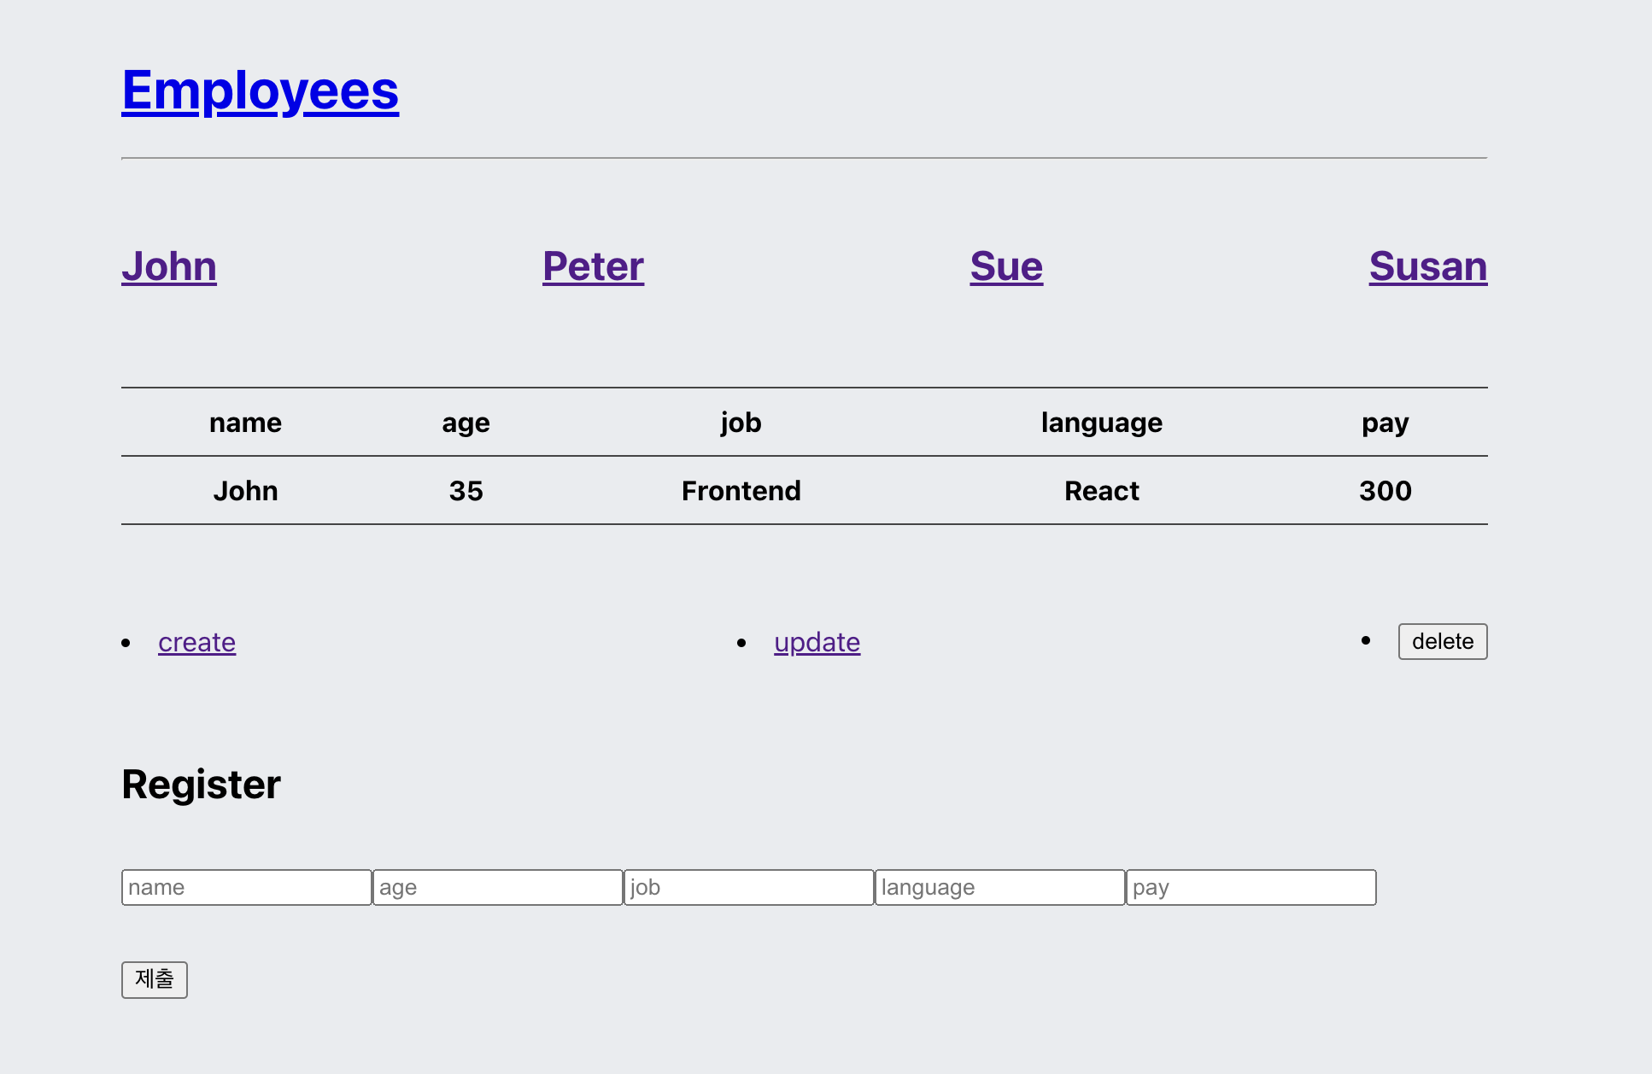
UI

Slide 45
styled
const Center = styled.div
` width: 800px; /* 원하는 너비로 설정하세요 */
height: 700px; /* 원하는 높이로 설정하세요 */
position: absolute;
top: 50%;
left: 50%;
transform: translate(-50%, -50%);`
const Employee = styled.nav
` display: flex;
flex-direction: row; /* 기본값이므로 생략해도 됩니다 */
justify-content: space-between; /* 요소들을 좌우로 고르게 분배합니다 */
align-items: center; /* 요소들을 수직으로 가운데 정렬합니다 */`
const Control = Employee;
const Table = styled.table
`width: 100%;
border-top: 1px solid #444444;
border-collapse: collapse;`
const Th = styled.th
`border-bottom: 1px solid #444444;
padding: 10px;`
const Td = Th;

Slide 46
state
import React, {useState} from "react";
import data from "./info.json"
import styled from "styled-components";
function App(){
const [mode, setMode] = useState('myPage');//myPage, Info
const [name, setName] = useState(''); // 사원 이름
const [control, setControl] = useState('create'); //create, update, delete
const [info, setInfo] = useState(data); // 사원 정보

Slide 47
Employee
return(
<Center>
<h1><a href='/employee'>Employees</a></h1>
<hr/>
<br/>
<Employee>
{data.map((datum)=>(
<h1>
<a href="/name">{datum.name}</a>
</h1>)
)
}
</Employee>
<br/>
<br/>

Slide 48
Info Table
<Table>
<thead>
<tr>
<Th>name</Th>
<Th>age</Th>
<Th>job</Th>
<Th>language</Th>
<Th>pay</Th>
</tr>
</thead>
<tr>
<Td>John</Td>
<Td>35</Td>
<Td>Frontend</Td>
<Td>React</Td>
<Td>300</Td>
</tr>
</Table>
<br/><br/><br/>

Slide 49
Controls
<Control>
<li>
<a href="/create">create</a>
</li>
<li>
<a href="/update">update</a>
</li>
<li>
<input type='button' value="delete"/>
</li>
</Control>
<br/>
<br/>

Slide 50
Control Form
<article>
<h2>Register</h2>
<form action="/create" method="post" >
<div style={{display:"flex", flexDirection: "row"}}>
<p><input type='text' name="name" placeholder="name">
</input></p>
<p><input type='text' name="age" placeholder="age">
</input></p>
<p><input type='text' name="job" placeholder="job">
</input></p>
<p><input type='text' name="language" placeholder="language">
</input></p>
<p><input type='text' name="pay" placeholder="pay">
</input></p>
</div>
<p><input type='submit'></input></p>
</form>
</article>
</Center>
)
}
export default App;

Slide 51
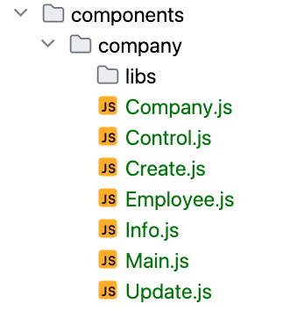
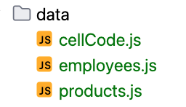
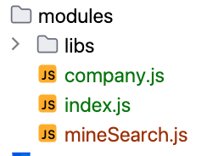
모듈 구성

Slide 52
Company.js
import React, {useCallback} from "react";
import {connect} from "react-redux";
import styled from "styled-components";
import Main from "./Main";
import Employee from "./Employee";
import Info from "./Info";
import Control from "./Control"
import Create from "./Create";
import Update from "./Update";
import {changeMode, changeName, changeControl, createInfo, updateInfo, deleteInfo} from "../../modules/company";

Slide 53
Company.js
export const Center = styled.div
` width: 800px; /* 원하는 너비로 설정하세요 */
height: 700px; /* 원하는 높이로 설정하세요 */
position: absolute;
top: 50%;
left: 50%;
transform: translate(-50%, -50%);`
function Company(props){
const {control,name, mode, infos} = props;
const {changeName, changeMode, changeControl,
createInfo, updateInfo, deleteInfo } = props;
const transferMode = useCallback( () => {
if(mode === "myPage"){
return [<Main mode={mode} handleMode={changeMode}></Main>,
<div>MyPage</div>]

Slide 54
Company.js
}else if(mode === "Info"){
return [
// <div>{name}</div>,
<Main mode={mode} handleMode={changeMode}></Main>,
<hr/>,<br/>,
<Employee infos={infos} handleName={changeName}></Employee>,
<br/>,<br/>,
<Info name={name} infos={infos}></Info>,
<br/>,<br/>,<br/>,
<Control handleControl={changeControl}
handleDel={deleteInfo}></Control>,
<br/>,<br/>,
[control === "create" ? <Create
infos={infos}
handleInfos={createInfo}/>
:<Update
name={name}
infos={infos}
handleInfos={updateInfo}/>]
]
}
}, [mode, name, control, infos]);

Slide 55
return(
<Center>
{transferMode()}
</Center>
)
}
export default connect(
({company})=>({
mode: company.mode,
control: company.control,
name: company.name,
infos: company.infos
}),
{
changeControl,
changeMode,
changeName,
createInfo,
updateInfo,
deleteInfo
}
)(Company);
Company.js

Slide 56
Control.js
import {Link} from "react-router-dom"
import styled from "styled-components";
const ControlDiv = styled.div
` display: flex;
flex-direction: row; /* 기본값이므로 생략해도 됩니다 */
justify-content: space-between; /* 요소들을 좌우로 고르게 분배합니다 */
align-items: center; /* 요소들을 수직으로 가운데 정렬합니다 */`
export default function Control(props){
const {handleControl, handleDel} = props;
const onClick = (e) =>{
handleControl(e.target.textContent);
}
const handleDelete =()=>{
// console.log("delete")
handleDel()
}

Slide 57
Control.js
return(
<>
<ControlDiv>
<li>
<Link onClick={onClick}>create</Link>
</li>
<li>
<Link onClick={onClick}>update</Link>
</li>
<li>
<input type='button' onClick={handleDelete} value="delete"/>
</li>
</ControlDiv>
</>
)
}

Slide 58
export default function Create(props) {
const {infos, handleInfos} = props;
const keys = Object.keys(infos[0]);
const onSubmit = (e) =>{
e.preventDefault();
handleInfos(e);
}
return(
<>
<article>
<h2>Register</h2>
<form onSubmit={onSubmit}>
<div style={{display:"flex", flexDirection: "row"}}>
{keys.map((key)=>(
<p><input type='text'
name={key}
placeholder={key}>
</input></p>))}
</div>
<p><button type='submit'>제출</button></p>
</form>
</article>
</>
)
}
Create.js

Slide 59
import React from "react";
import {Link} from "react-router-dom";
import styled from "styled-components";
const EmployeeNav = styled.nav
` display: flex;
flex-direction: row; /* 기본값이므로 생략해도 됩니다 */
justify-content: space-between; /* 요소들을 좌우로 고르게 분배합니다 */
align-items: center; /* 요소들을 수직으로 가운데 정렬합니다 */`
export default function Employee(props) {
const {handleName, infos} = props;
const onClick = (n) => {
// console.log(n)
handleName(n);
}
return (
<EmployeeNav>
{infos.map((info)=>(
<h1 onClick={()=>onClick(info.name)}>
<Link>{info.name}</Link>
</h1>)
)}
</EmployeeNav>)
}
Employee.js

Slide 60
Info.js
import React from "react";
import styled from "styled-components";
const Table = styled.table
`width: 100%;
border-top: 1px solid #444444;
border-collapse: collapse;`
const Th = styled.th
`border-bottom: 1px solid #444444;
padding: 10px;`
const Td = Th;
export default function Info(props){
const {name, infos} = props;
return(

Slide 61
Info.js
return(
<Table>
<thead>
<tr>
<Th>name</Th>
<Th>age</Th>
<Th>job</Th>
<Th>language</Th>
<Th>pay</Th>
</tr>
</thead>
<tr>
{infos.map((info)=> info.name=== name &&
[ <Td>{info.name}</Td>,
<Td>{info.age}</Td>,
<Td>{info.job}</Td>,
<Td>{info.language}</Td>,
<Td>{info.pay}</Td> ])}
</tr>
</Table>
)
}

Slide 62
Main.js
import React, {useCallback} from 'react';
import {Link} from "react-router-dom"
export default function Main(props){
const { mode, handleMode } = props;
const onClick = useCallback((e) => {
if(mode === "myPage"){
e.target.textContent = "Main";
handleMode("Info")
}else{
e.target.textContent = "Employees";
handleMode("myPage");
}
},[mode]);
return(
<>
<h1><Link onClick={onClick}>Employees</Link></h1>
</>
)
}

Slide 63
Update.js
import React from "react";
export default function Update(props) {
const {name, infos, handleInfos} = props;
let keys = Object.keys(infos[0]);
keys = keys.slice(1);
const onSubmit = (e) =>{
e.preventDefault();
handleInfos(e);
}

Slide 64
Update.js
return(
<>
<article>
<h2>UpGrade</h2>
<form onSubmit={onSubmit}>
<div style={{display:"flex", flexDirection: "row"}}>
<p><input
type='hidden'
name="name"
placeholder="name">
</input></p>
{keys.map((key)=>(<p><input
type='text'
name={key}
placeholder={key}>
</input></p>))}
</div>
<p><button type='submit'>제출</button></p>
</form>
</article>
</>
)
}

Slide 65
Info.js
import React from "react";
import styled from "styled-components";
const Table = styled.table
`width: 100%;
border-top: 1px solid #444444;
border-collapse: collapse;`
const Th = styled.th
`border-bottom: 1px solid #444444;
padding: 10px;`
const Td = Th;
export default function Info(props){
const {name, infos} = props;
// console.log(infos);

Slide 66
company.js
import {employees} from "../data/employees";
const CHANGEMODE = "compayn/CHANGEMODE"
const CHANGENAME = "compayn/CHANGENAME"
const CHANGECONTROL = "compayn/CHANGECONTROL"
const CREATEINFO = "compayn/CREATEINFO"
const UPDATEINFO = "compayn/UPDATEINFO"
const DELETEINFO = "compayn/DELETEINFO"
export const changeMode = (mode)=>({type:CHANGEMODE, mode})
export const changeName = (name)=>({type:CHANGENAME, name})
export const changeControl = (control)=>({type:CHANGECONTROL, control})
export const createInfo = (event)=>({type:CREATEINFO, event})
export const updateInfo = (event)=>({type:UPDATEINFO, event})
export const deleteInfo = ()=>({type:DELETEINFO})

Slide 67
company.js
const initialState = {
infos: employees,
mode: "myPage",
name: employees[0].name,
control: "create"
}
export const company =(state=initialState, actions)=>{
switch (actions.type){
case CHANGEMODE:
return{
...state,
mode: actions.mode
}
case CHANGENAME:
return{
...state,
name: actions.name
}

Slide 68
company.js
case CHANGECONTROL:
return{
...state,
control: actions.control
}
case CREATEINFO:
const ckeys = Object.keys(state.infos[0]);
let cinfo = {};
ckeys.forEach((key)=>{
cinfo[key] = actions.event.target[key].value;
actions.event.target[key].value = '';
})
return{
...state,
infos: [...state.infos, cinfo]
}

Slide 69
company.js
case UPDATEINFO:
let keys = Object.keys(state.infos[0]);
keys = keys.slice(1)
let newInfos = [...state.infos];
for(let i=0; i<newInfos.length; i++){
if(newInfos[i].name === state.name){
let obj = {...newInfos[i]}
for(let key of keys){
if(actions.event.target[key].value==='') continue;
obj = {...obj, [actions.event.target[key].name]
:actions.event.target[key].value}
actions.event.target[key].value = '';
}
newInfos[i]= obj;
break;
}
}

Slide 70
company.js
return{
...state,
infos: newInfos
}
case DELETEINFO:
console.log(state.name)
const delInfos = [...state.infos].filter(info=>info.name!==state.name)
console.log(delInfos)
return{
...state,
infos: delInfos
}
default:
return state;
}
}

Slide 71
redux
useSelector, useDispatch, useStore

Slide 72
Company.js
import React, {useCallback} from "react";
import {useSelector} from "react-redux";
import styled from "styled-components";
import Main from "./Main";
import Employee from "./Employee";
import Info from "./Info";
import Control from "./Control"
import Create from "./Create";
import Update from "./Update";

Slide 73
Company.js
export const Center = styled.div
` width: 800px; /* 원하는 너비로 설정하세요 */
height: 700px; /* 원하는 높이로 설정하세요 */
position: absolute;
top: 50%;
left: 50%;
transform: translate(-50%, -50%);`
function Company(props){
const {mode, control}
= useSelector(({company})=>({mode:company.mode, control:company.control}))
const transferMode = useCallback( () => {
if(mode === "myPage"){
return [<Main></Main>,
<div>MyPage</div>]

Slide 74
Company.js
}else if(mode === "Info"){
return [
<Main></Main>,
<hr/>,<br/>,
<Employee></Employee>,
<br/>,<br/>,
<Info></Info>,
<br/>,<br/>,<br/>,
<Control ></Control>,
<br/>,<br/>,
control === "create" ? <Create /> :<Update />
]
}
}, [mode,control]);
return(
<Center>
{transferMode()}
</Center>
)
}
export default Company;

Slide 75
Control.js
import {Link} from "react-router-dom"
import styled from "styled-components";
import {useDispatch} from "react-redux";
import {deleteInfo, changeControl} from "../../modules/company";
const ControlDiv = styled.div
` display: flex;
flex-direction: row; /* 기본값이므로 생략해도 됩니다 */
justify-content: space-between; /* 요소들을 좌우로 고르게 분배합니다 */
align-items: center; /* 요소들을 수직으로 가운데 정렬합니다 */`
export default function Control(props){
const dispatch = useDispatch();
const onClick = (e) =>{
dispatch(changeControl(e.target.textContent));
}
const handleDelete =()=>{
dispatch(deleteInfo())
}

Slide 76
Control.js
return(
<>
<ControlDiv>
<li>
<Link onClick={onClick}>create</Link>
</li>
<li>
<Link onClick={onClick}>update</Link>
</li>
<li>
<input type='button' onClick={handleDelete} value="delete"/>
</li>
</ControlDiv>
</>
)
}

Slide 77
Create.js
import React from "react";
import {useSelector, useDispatch} from "react-redux";
import {createInfo} from "../../modules/company";
export default function Create(props) {
const infos = useSelector(({company})=>company.infos)
const dispatch = useDispatch();
const keys = Object.keys(infos[0]);
const onSubmit = (e) =>{
e.preventDefault();
dispatch(createInfo(e));
}

Slide 78
Create.js
return(
<>
<article>
<h2>Register</h2>
<form onSubmit={onSubmit}>
<div style={{display:"flex", flexDirection: "row"}}>
{keys.map((key)=>(
<p><input type='text'
name={key}
placeholder={key}>
</input></p>))}
</div>
<p><button type='submit'>제출</button></p>
</form>
</article>
</>
)
}

Slide 79
Employee.js
import React from "react";
import {Link} from "react-router-dom";
import styled from "styled-components";
import {useSelector, useDispatch} from "react-redux";
import {changeName} from "../../modules/company";
const EmployeeNav = styled.nav
` display: flex;
flex-direction: row; /* 기본값이므로 생략해도 됩니다 */
justify-content: space-between; /* 요소들을 좌우로 고르게 분배합니다 */
align-items: center; /* 요소들을 수직으로 가운데 정렬합니다 */`

Slide 80
Employee.js
export default function Employee(props) {
const infos = useSelector(state=>state.company.infos)
const dispatch = useDispatch();
const onClick = (n) => {
dispatch(changeName(n))
}
return (
<EmployeeNav>
{infos.map((info)=>(
<h1 onClick={()=>onClick(info.name)}>
<Link>{info.name}</Link>
</h1>)
)}
</EmployeeNav>
)}

Slide 81
Info.js
import React from "react";
import styled from "styled-components";
import {useSelector} from "react-redux";
const Table = styled.table
`width: 100%;
border-top: 1px solid #444444;
border-collapse: collapse;`
const Th = styled.th
`border-bottom: 1px solid #444444;
padding: 10px;`
const Td = Th;

Slide 82
Info.js
export default function Info(props){
const {name, infos}
= useSelector(({company})=>({name:company.name, infos:company.infos}))
return(
<Table>
<thead>
<tr>
<Th>name</Th>
<Th>age</Th>
<Th>job</Th>
<Th>language</Th>
<Th>pay</Th>
</tr>
</thead>

Slide 83
Info.js
<tr>
{infos.map((info)=> info.name=== name &&
[ <Td>{info.name}</Td>,
<Td>{info.age}</Td>,
<Td>{info.job}</Td>,
<Td>{info.language}</Td>,
<Td>{info.pay}</Td> ])}
</tr>
</Table>
)
}

Slide 84
Main.js
import React, {useCallback} from 'react';
import {Link} from "react-router-dom"
import {useSelector, useDispatch} from "react-redux";
import {changeMode} from "../../modules/company";
export default function Main(props){
const mode = useSelector(({company})=>company.mode)
const dispatch = useDispatch()
const onClick = useCallback((e) => {
if(mode === "myPage"){
e.target.textContent = "Main";
dispatch(changeMode("Info"))
}else{
e.target.textContent = "Employees";
dispatch(changeMode("myPage"));
}
},[mode]);
return(
<>
<h1><Link onClick={onClick}>Employees</Link></h1>
</>
)}

Slide 85
Update.js
import React from "react";
import {useStore} from "react-redux";
import {updateInfo} from "../../modules/company";
export default function Update(props) {
const store = useStore();
const {name, infos} = store.getState().company
let keys = Object.keys(infos[0]);
keys = keys.slice(1);
const onSubmit = (e) =>{
e.preventDefault();
store.dispatch(updateInfo(e));
}

Slide 86
Update.js
return(
<>
<article>
<h2>UpGrade</h2>
<form onSubmit={onSubmit}>
<div style={{display:"flex", flexDirection: "row"}}>
<p><input
type='hidden'
name="name"
placeholder="name">
</input></p>
{keys.map((key)=>(<p><input
type='text'
name={key}
placeholder={key}>
</input></p>))}
</div>
<p><button type='submit'>제출</button></p>
</form>
</article>
</>
)
}

